Slide 1
Customer Service Etiquette
Presented by: Michael A. Ludwig
IT Analyst

Slide 2
The following information can be attained via the web links below.
https://medium.com/business-startup-development-and-more/customer-service-etiquette-what-to-say-and-what-to-avoid-9142d2791312
https://www.businesstrainingworks.com/training-resource/customer-service-etiquette/
https://www.thebalancesmb.com/providing-excellent-customer-service-2951744
https://www.customerservicemanager.com/dealing-with-customers-complaints/

Slide 3
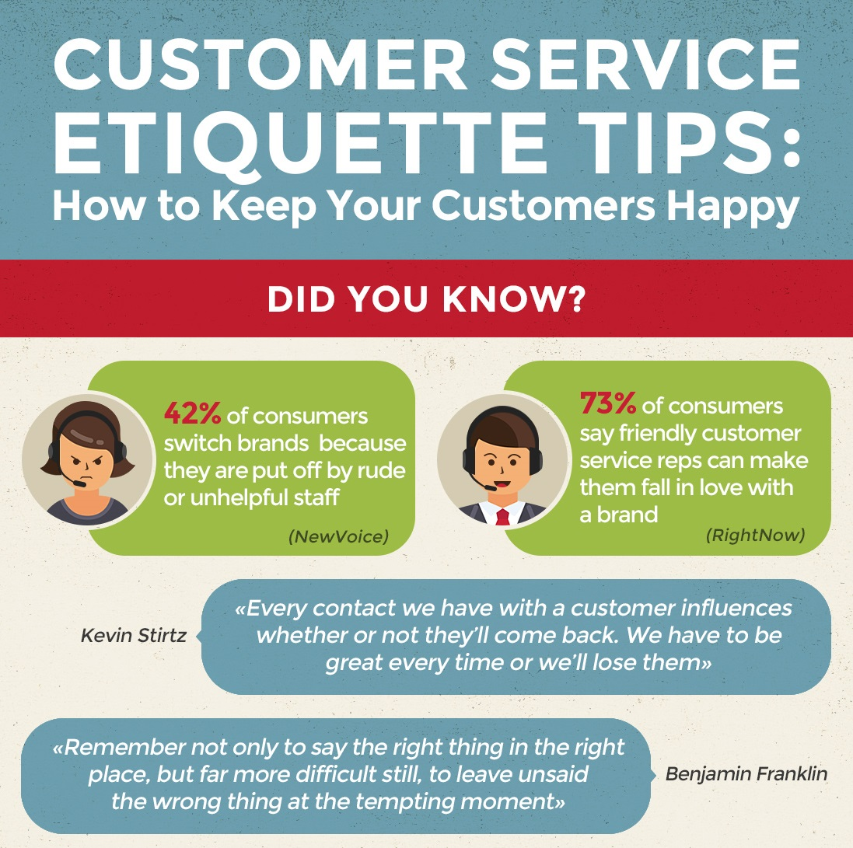
Lets start with the basics.
We will stop at each slide to elaborate and to share questions and experiences that are positive and have made you a better tech.
Please keep in mind in order to have a positive customer service experience, a positive attitude with positive emotions will win each time.
How we as technical people handle our customers is important. Each team member is a representative of the IT Department and as a member it is our job to sell our services to our customers every time we work a ticket.
An unhappy customer is bad for the whole team.

Slide 4
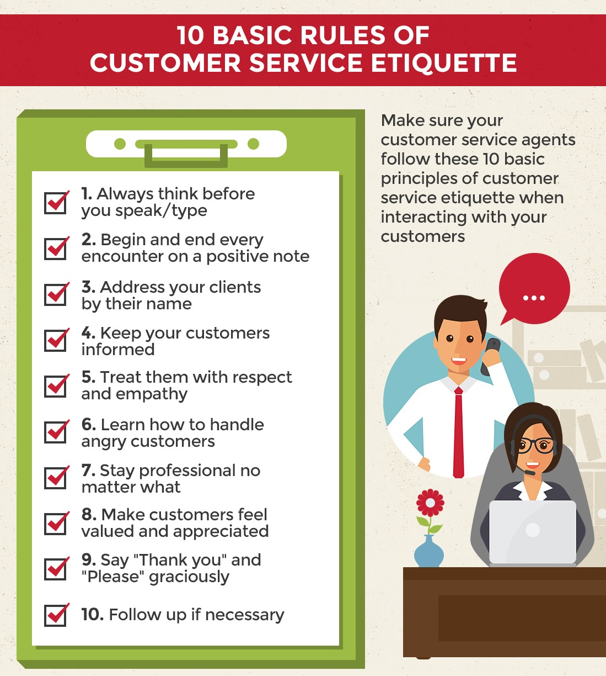
10 Basic Rules of Customer Service Etiquette
In customer service we cannot address or speak to our customers as we would our teammates in our department.
We must follow the 10 Basic Rules or Customer Service Etiquette show here to the right.
We will discuss ways to navigate these rules when finish this slide.

Slide 5
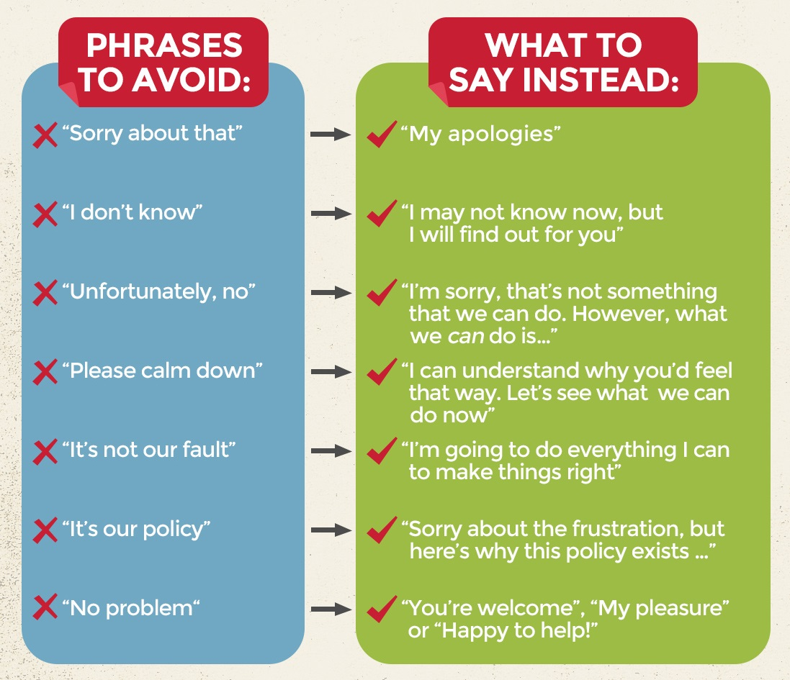
What we say is important.
Even when we use polite terms to give bad news, our vocabulary still needs to be consistently helpful and working towards a solution.
How we interact, speak, and take time with our customers allows us to interact with them professionally while working on a ticket.
Showing understanding by actively listening and communicating back when asked a question that pertains to your scope of work. Focus an answering their questions in a way they will understand, without showing off how smart you are.

Slide 6
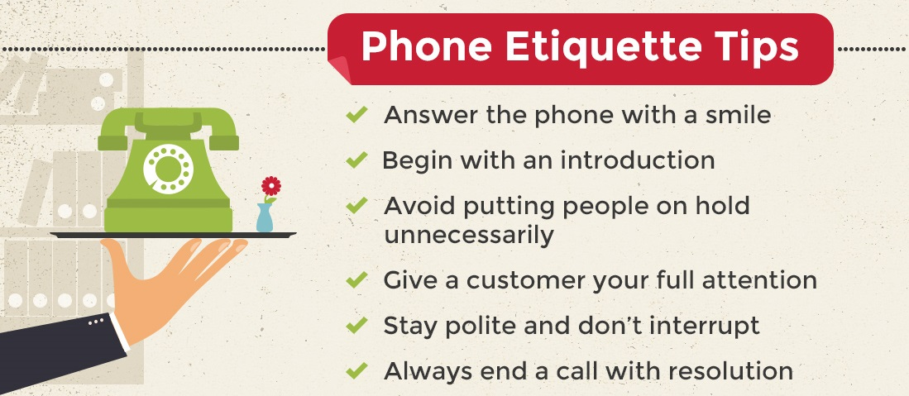
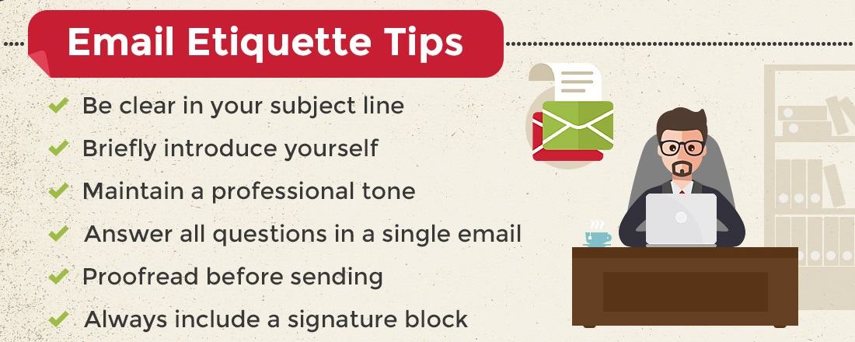
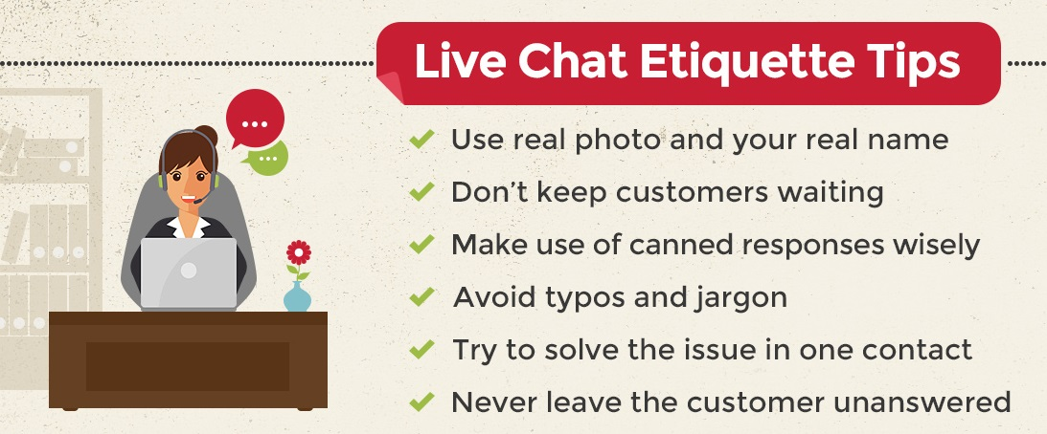
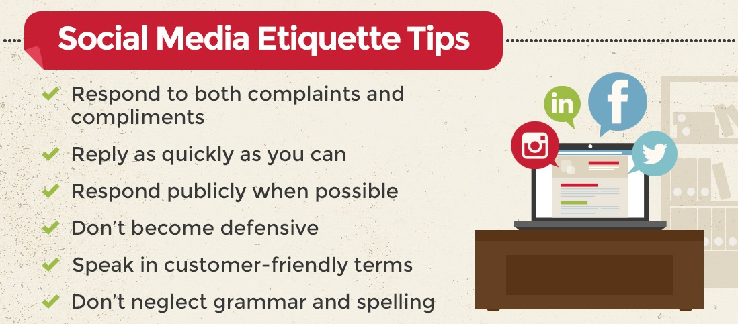
Let us examine the following 4 examples below.

Slide 7
How we initiate communication with customers over the phone is very important. Customers who are having to call a help desk are in some cases probably unhappy about an issue that they are experiencing.

Slide 8
Email means you have to check your spelling and watch your grammar. Also I was told never email angry.

Slide 9
If the customer does not respond after you initiate contact three times contact your supervisor. In addition depending on the customer watch the use of emoji’s.

Slide 10
Even when you think your managers aren’t watching someone is so keep your personal social media in-line with how your organization presents itself.

Slide 11
The ABC’s of Good Customer Service Etiquette
A is for Attention to Detail. Because when customers know you care passionately about the little things, they’ll know you care a great deal more about the big things.
B is for Benefits which is all your customer wants you to tell them.
C is for Complaints, your free marketing service.
D is for Dedicated staff, because when the team is fully engaged, customer loyalty goes up by two-thirds.
E is for Empowerment which means trusting and training your staff to do whatever it takes to thrill the customer.
F is for Feelings. As the Scottish Life advert says: “Make each customer feel like you’ve held the door open whilst laying your jacket across a puddle and then rescued their kitten from a tree.”
G is for Going Out Of Your Way, just like the engineer who took a 50-mile detour on his way home from work just to deliver a phone to a customer who had been waiting all day for it.
H is for Hi-Tech, Hi-Touch, because when things get complicated, that’s when people want the personal touch.
I is for Ichiban, the Japanese word for “wanting to be the best”.
J is for the customer Journey, which you must know every inch of.
K is for Kaizen, another Japanese word which means “continuous improvement”.
L is for Loyalty, which you buy by engaging their minds and piercing their hearts.
M is for Moments of Truth, those hundreds of opportunities every day to turn their heads.

Slide 12
ABC’s Continued
N is for Now For Something Extra, that ends every customer interaction on a high.
O is for Observing your customers’ needs before they know them themselves.
P is for the Pride that staff feel when they know they’re in a valued profession.
Q is for Quality: of product, of service, of manners, of courteousness.
R is for the golden Rule: the customer is always right, even when they’re wrong.
S is for Sincere Smiles, that aren’t false but melt the coldest hearts.
T is for Tact, the one thing your customers will notice but you must pretend not to.
U is for Under promise and Over deliver, the simplest way to make someone’s day.
V is for adding Value because there’s nothing so precious as your time, your care and your attention.
W is for the Wow Factor, when you stop them in their tracks.
X is for eXtraordinary service that is out of this world.
Y is for Your Mum Was Right, because it’s all about respect.
Z is for a good night’s Zzzzz’s after a great day’s work.

Slide 13
What does the acronym B.L.A.S.T mean.
B.L.A.S.T. is a great tool that is used by companies such as Yum! (Parent company of KFC, Taco Bell, Pizza Hut, A&W, and Long John Silvers). The acronym stands for:
Believe Listen Apologize Satisfy Thank
Not an official Osage IT Department saying however after my research I feel it is a good thing to practice and keep in mind.

Slide 14
Remember we all strive to be professionals and shall remain so. Even when the customer is rude and you feel like you being treated unfairly. We must be better, and we will be, for example Albert Einstein quoted the following: “Weak people take revenge. Strong ones forgive. Intelligent ignore! “

Slide 15
The End

